Slide 1
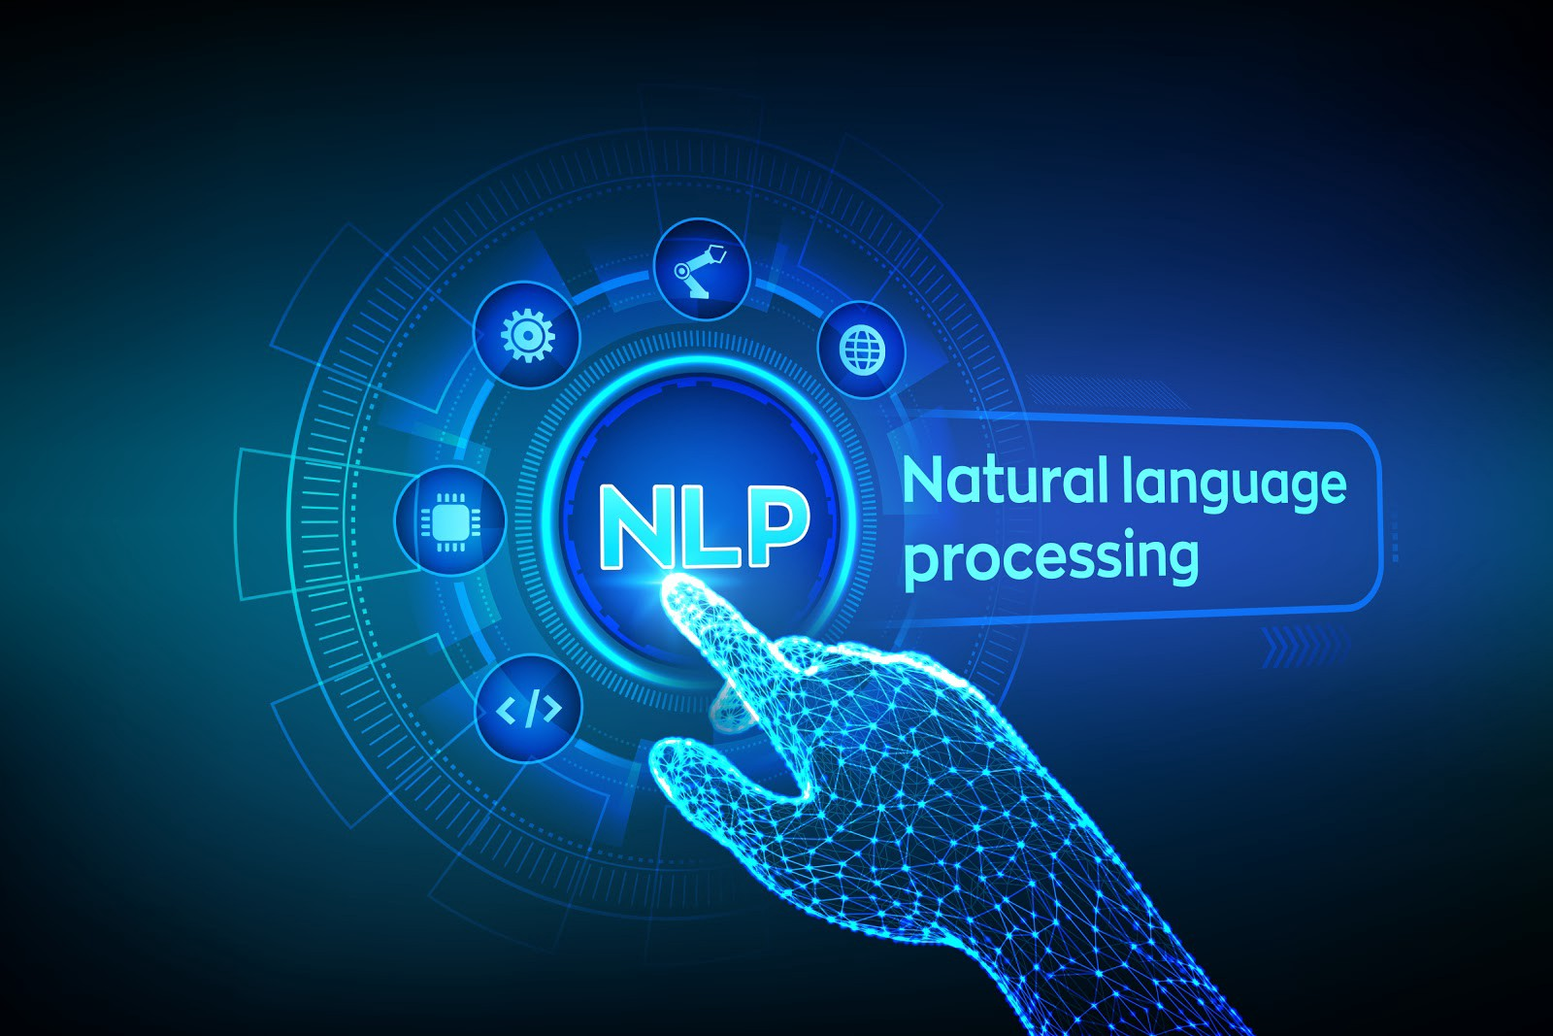
R. Joseph Manoj Ph.D.

Slide 2


Session Plan
Natural language processing – An Introduction
NLP Application
NLP Techniques
NLP Using NLTK
NLP Using spacy

Slide 3




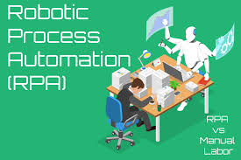


Slide 5
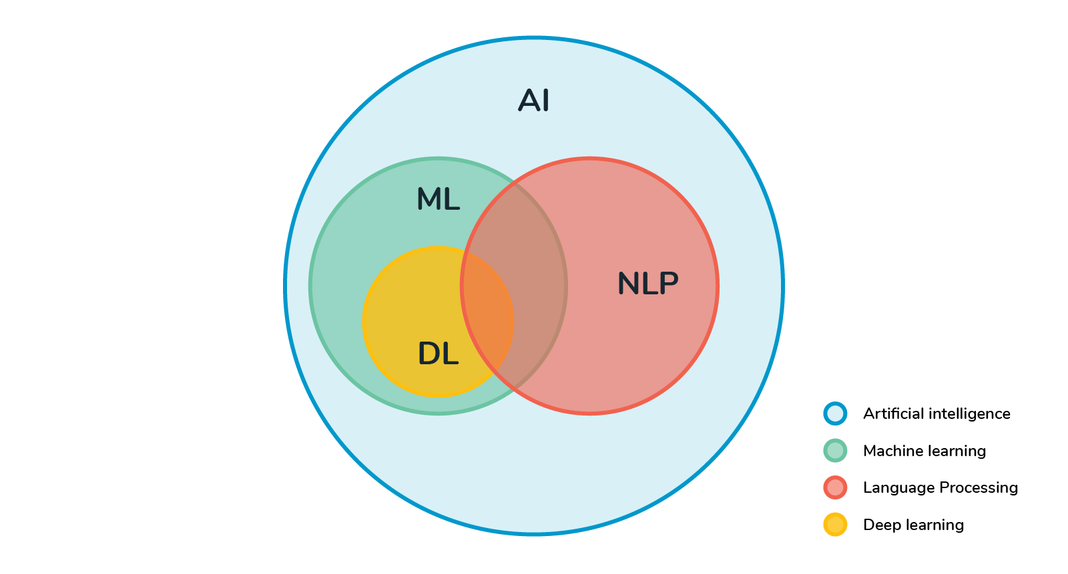
Natural Language Processing (NLP)
Natural Language Processing or NLP is a field of Artificial Intelligence that gives the machines the ability to read, understand and derive meaning from human languages.
It deals mostly with unstructured data such as social media posts, email.
It is originated from the idea of Machine Translation (MT) which came to existence during the second world war (1940). For example, turning the Russian language to English language.
MT/NLP era started during 1966. This condition was better in the 1980 when the product provided result to customer (Speech understanding Application).
Neural Machine Translation (NMT) or deep learning models are introduced in NLP Applications.

Slide 6
NLP Applications
NLP market is segmented into BFSI, healthcare, retail and ecommerce, manufacturing, media and entertainment, travel and hospitality, IT & telecommunication, and others.
Amazon Alexa , Apple SIRI, Facebook M, Google Assistant, Microsoft Cortona, Robots, Chat bot, RPA Applications
Royal Bank of Scotland (RBS) uses text analytics, an NLP technique, to extract important trends from customer feedback in many forms. The company analyzes data from emails, surveys and call center conversations to identify the root cause of customer dissatisfaction and implement improvements.
Through the infusion of NLP and machine learning in agriculture, farmers would be able to communicate and learn from their peers and with civic bodies in their local language.
NLP has been successful in improving the healthcare process and outcomes by effectively interpreting clinical notes. It extracts details from diagnostic reports and doctors' letters, and ensures the completeness and accuracy of patient health profile.
NLP enables us to analyze financial documents such as 10k forms to forecast stock movements and sentiment analysis.
HR Analytics such as performance analysis and Hiring process.
National Security, Energy and Entertainment services.

Slide 7
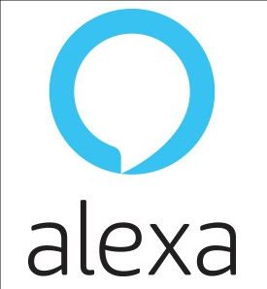
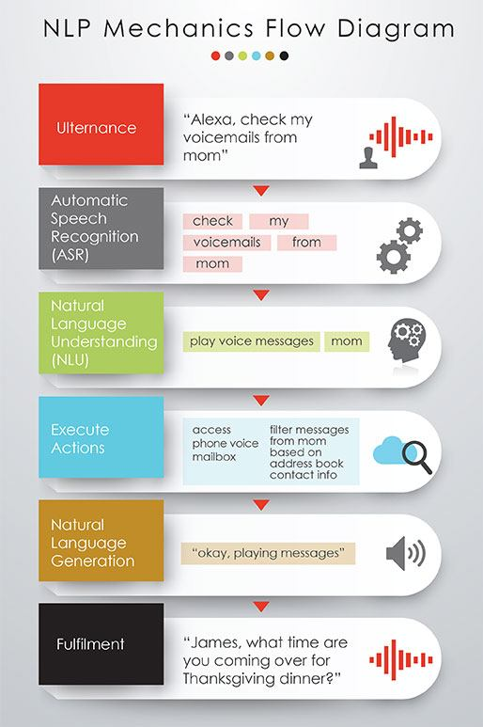

Slide 9
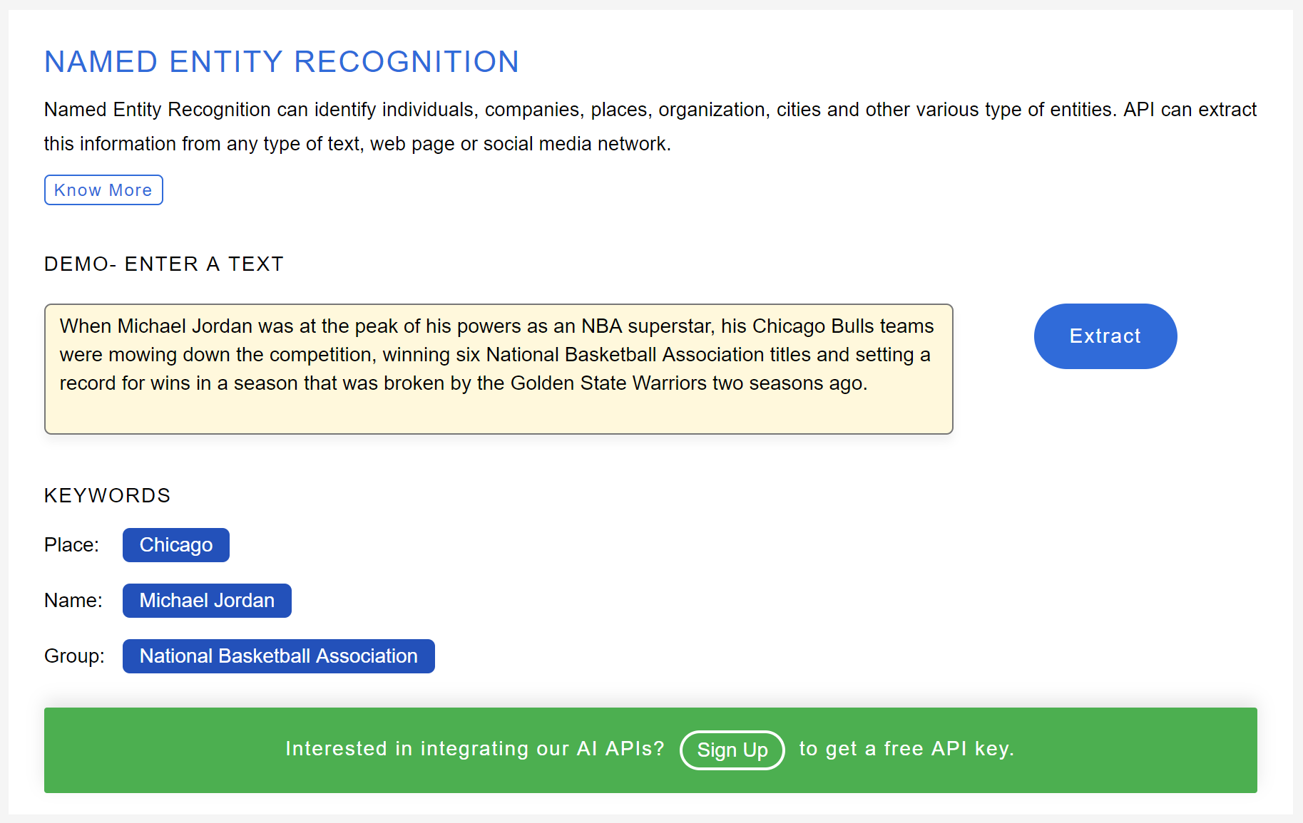
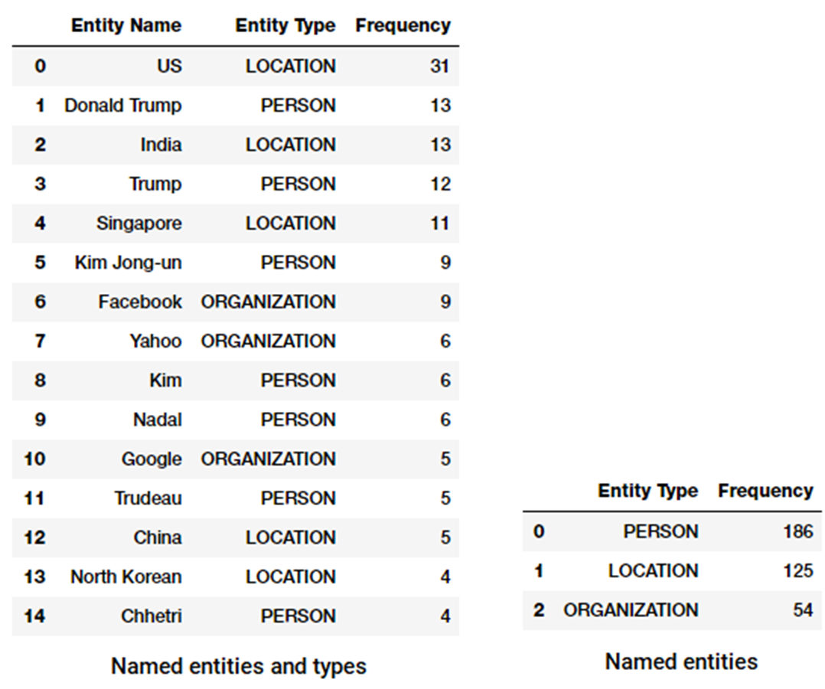

Slide 10
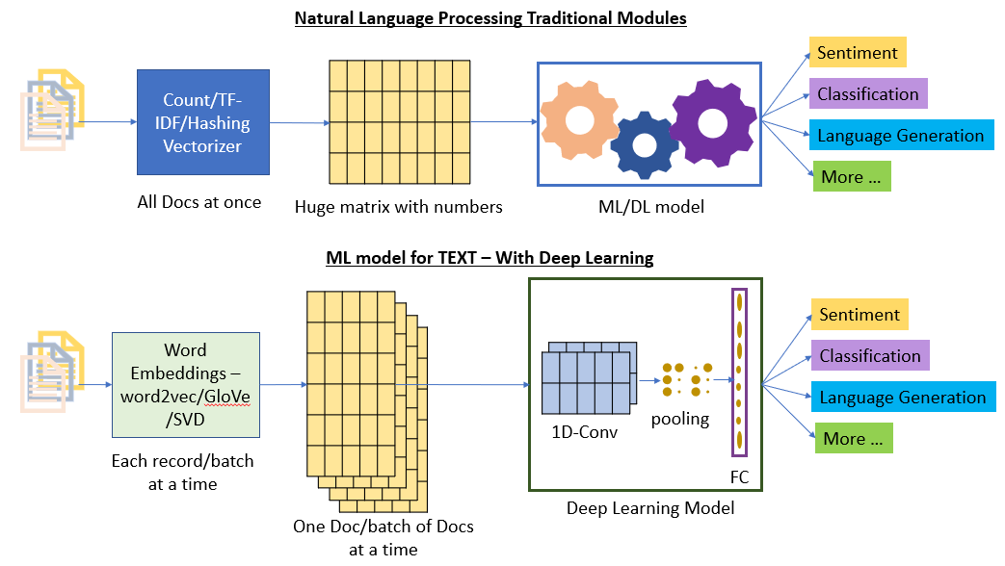

Slide 11
NLP Tools
NLTK, Scipy, Carrot2 – Libraries for Python Environment
Amazon Comprehend - Uses machine learning to find insights and relationships in text
Google Cloud NL API - AutoML NLP API’s
Apache OpenNLP, Tika (open source-JAVA Based)
CLARIN Infrastructure
Azure NLP

Slide 12
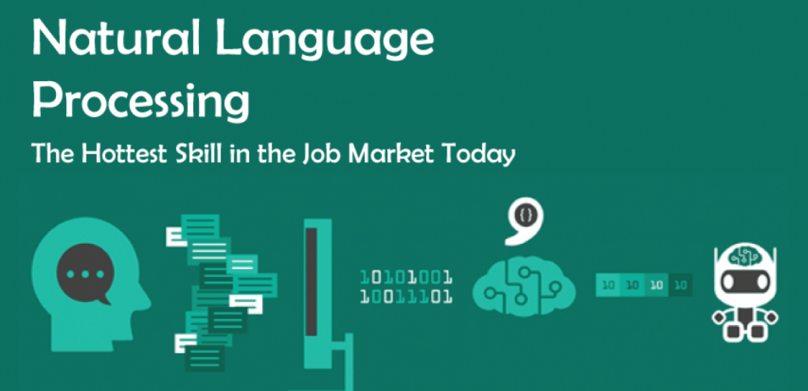

Slide 13
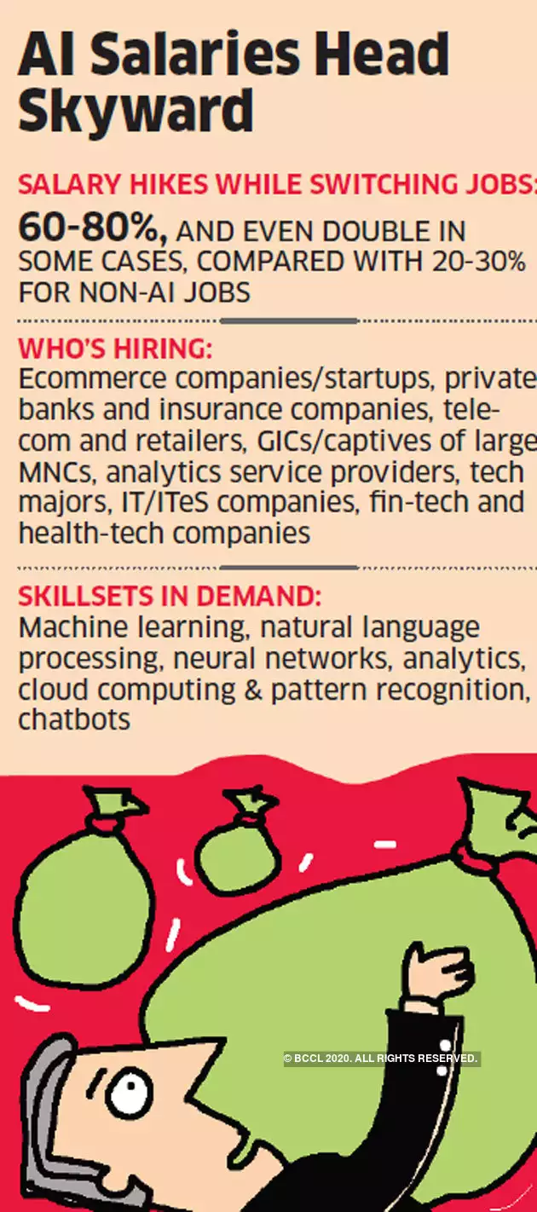

Slide 14

NLP Pre-Processing Using NLTK & Spacy

Slide 15


